Slide 1
Python
Thank you Guido
Van Rossum

Slide 2
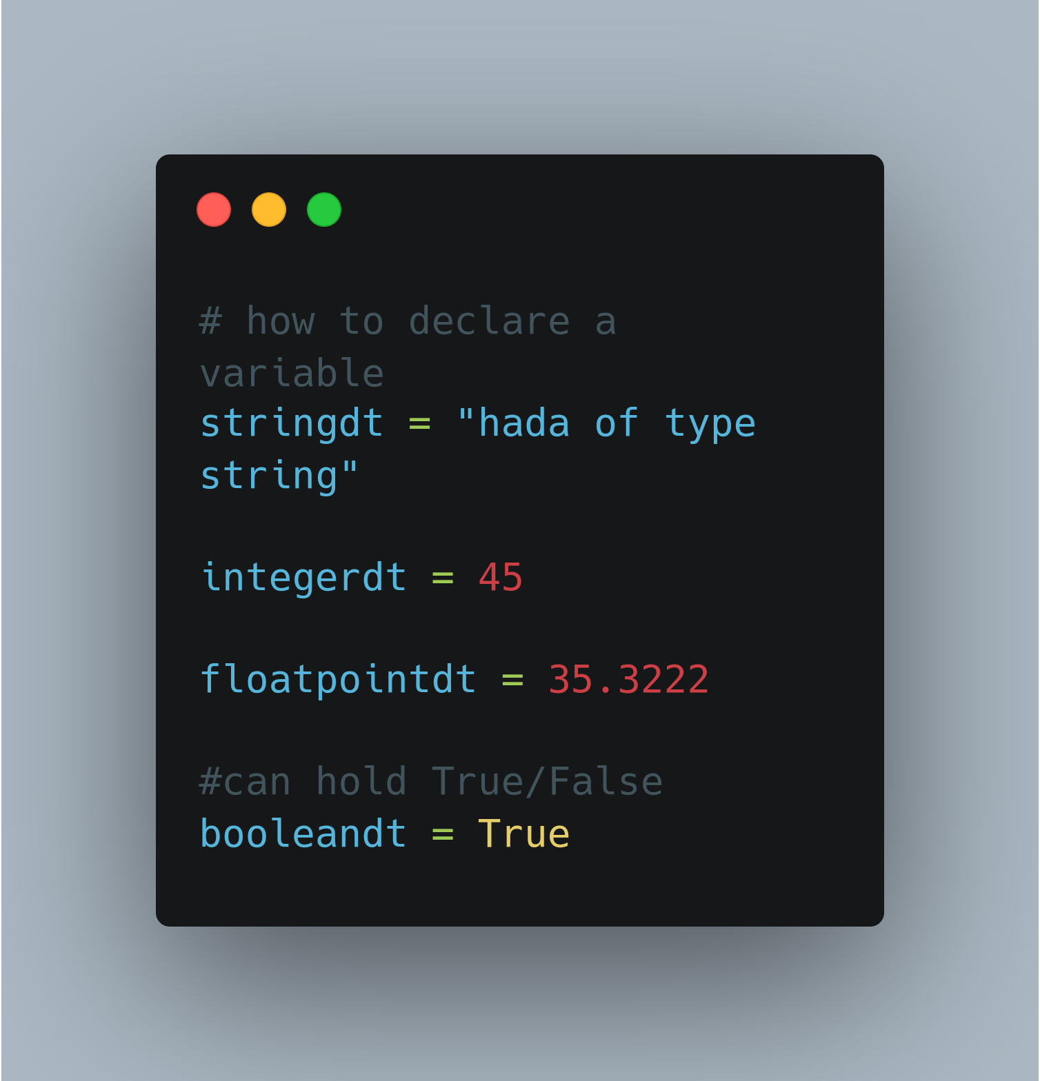
Variables

Slide 3
Other Important Data Types
Dictionary
mydiction = {“goalOne”: “learn python”, “goalTwo”: “get hands on experience and nail the fundamentals”}
Uses Keys and it's corresponding value
Mutable
List
list1=[“hi”, “there”, “lets”, “learn”, “python”]
Indexed i.e. to output “there”
print(list1[1])
Mutable
Tuple
mytuple=(“this”, “is”, “a”, “tuple”)
Immutable
Indexed

Slide 4
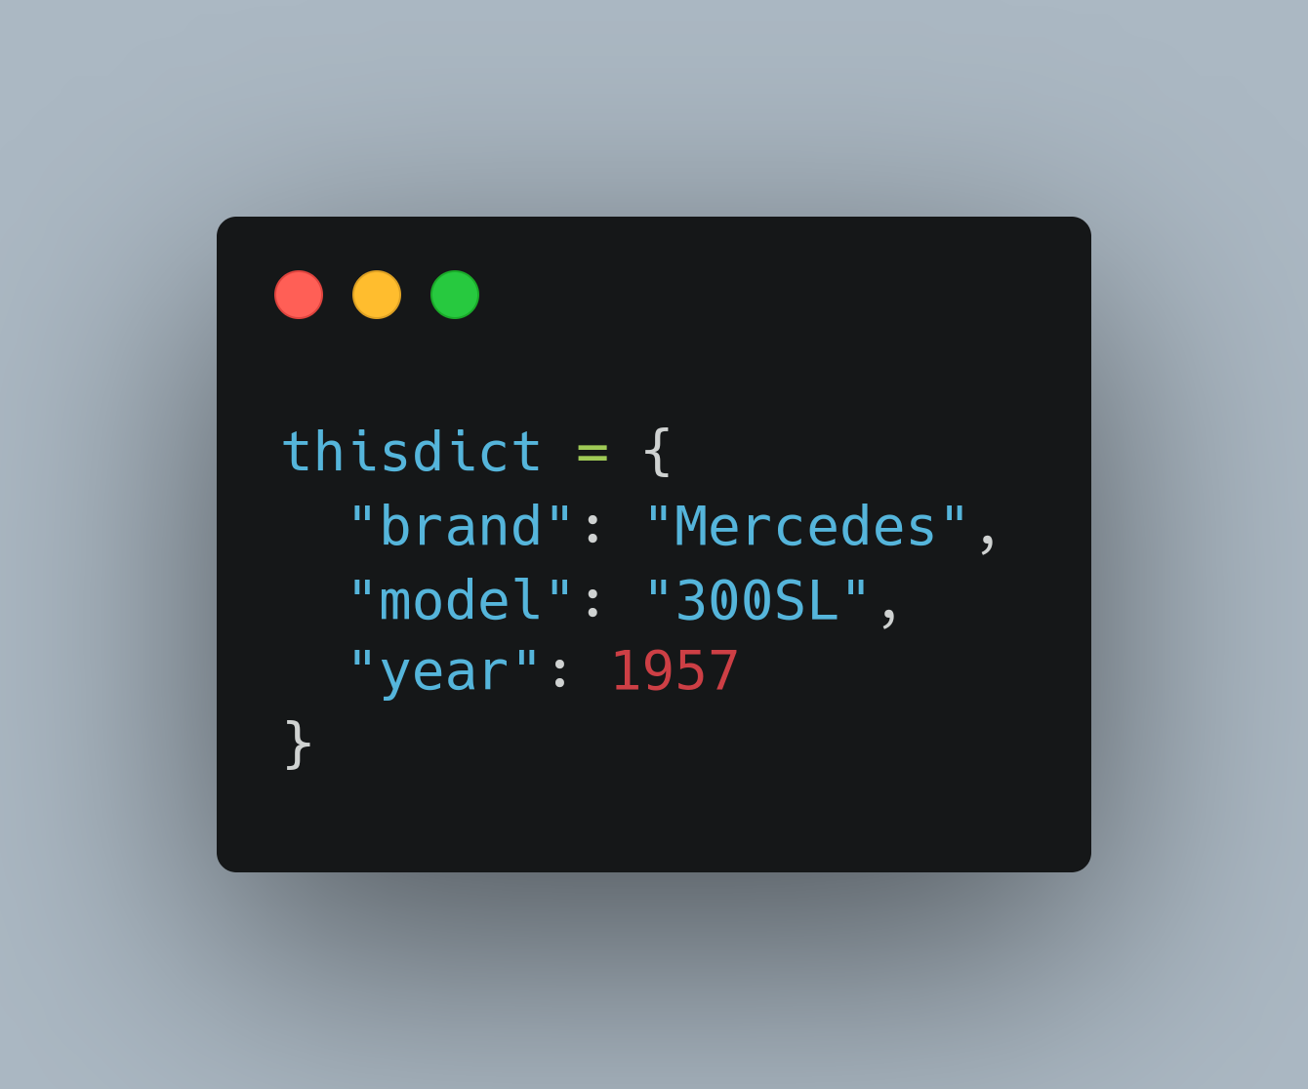
Examples
Of Other DT1

Slide 5
Operators
Logical Operators
and
mylist1=[6, “am”, “employed", “full-time”]
mylist2=[6, “am”, “studying”, “full-time”]
print(6 in (mylist1 and mylist2))
Both must be true to satisfy
or
Only one has to be true for it to evaluate to true
Comparison Opeators( ==, !=)
valone = 6
valtwo = 2
print(valone==valtwo) #False
print(valone!=valtwo) #True
Arithmetic Operators
+,-,*,/,%, **, //

Slide 6
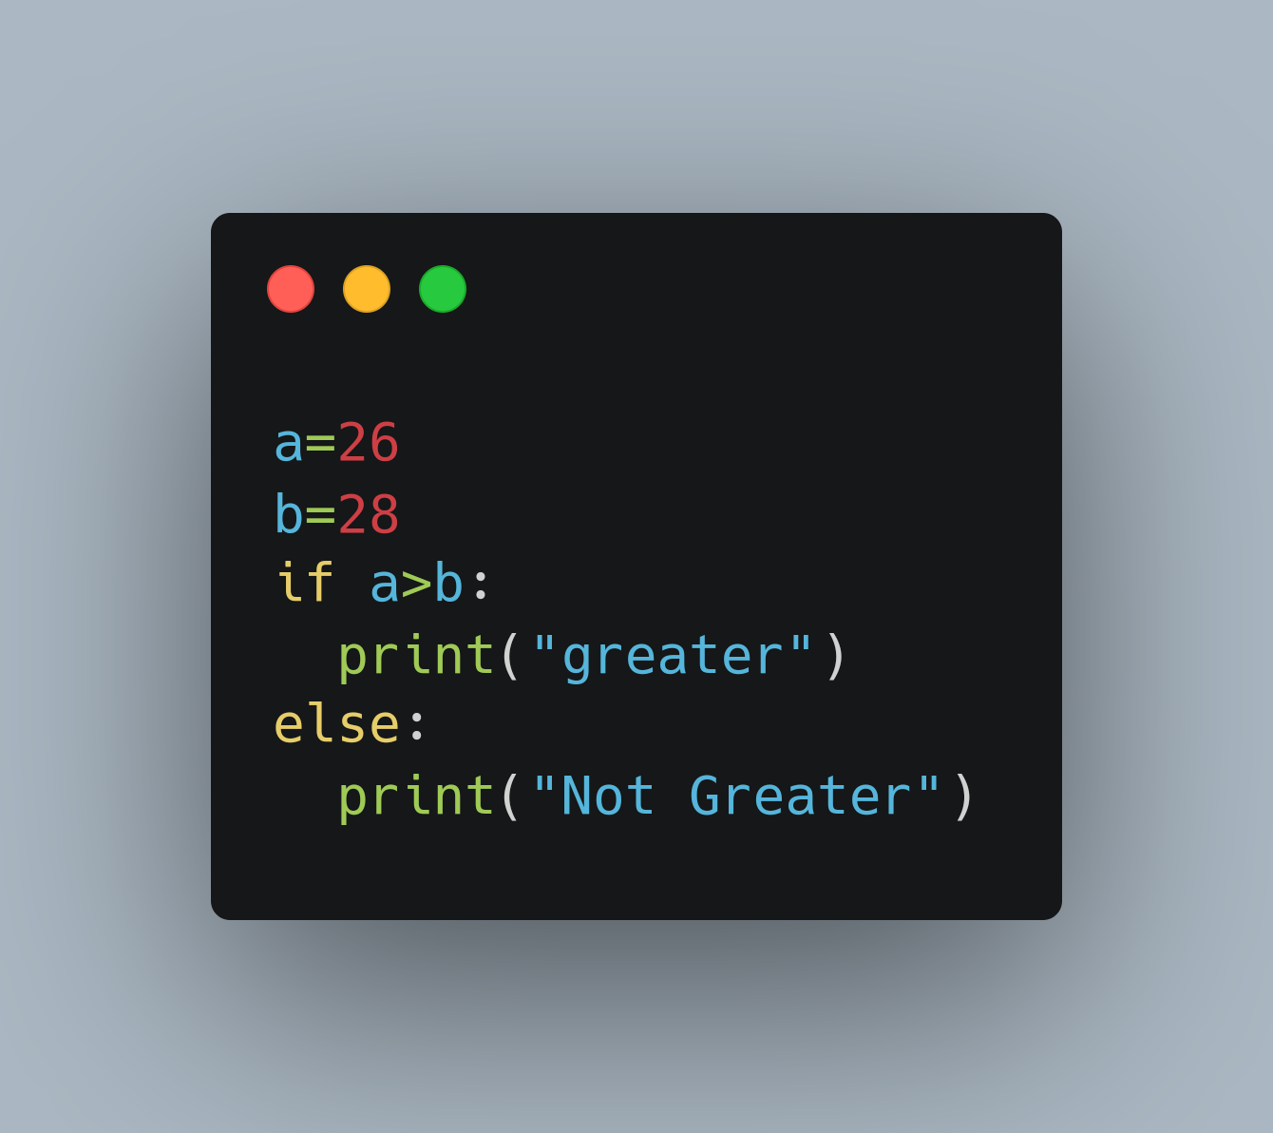
Conditionals
Strictly greater… >

Slide 7
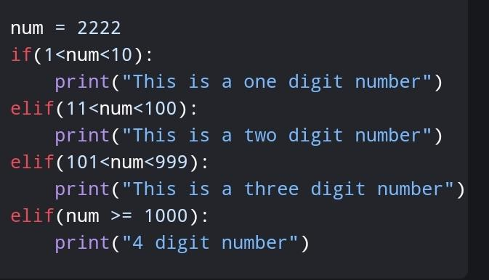
Conditionals

Slide 8
Comments
To place a single line comment:
Place a hashtag then comment whatever you want
To place a multi-line comment
Use three single quotation marks ie apostrophes

Slide 9
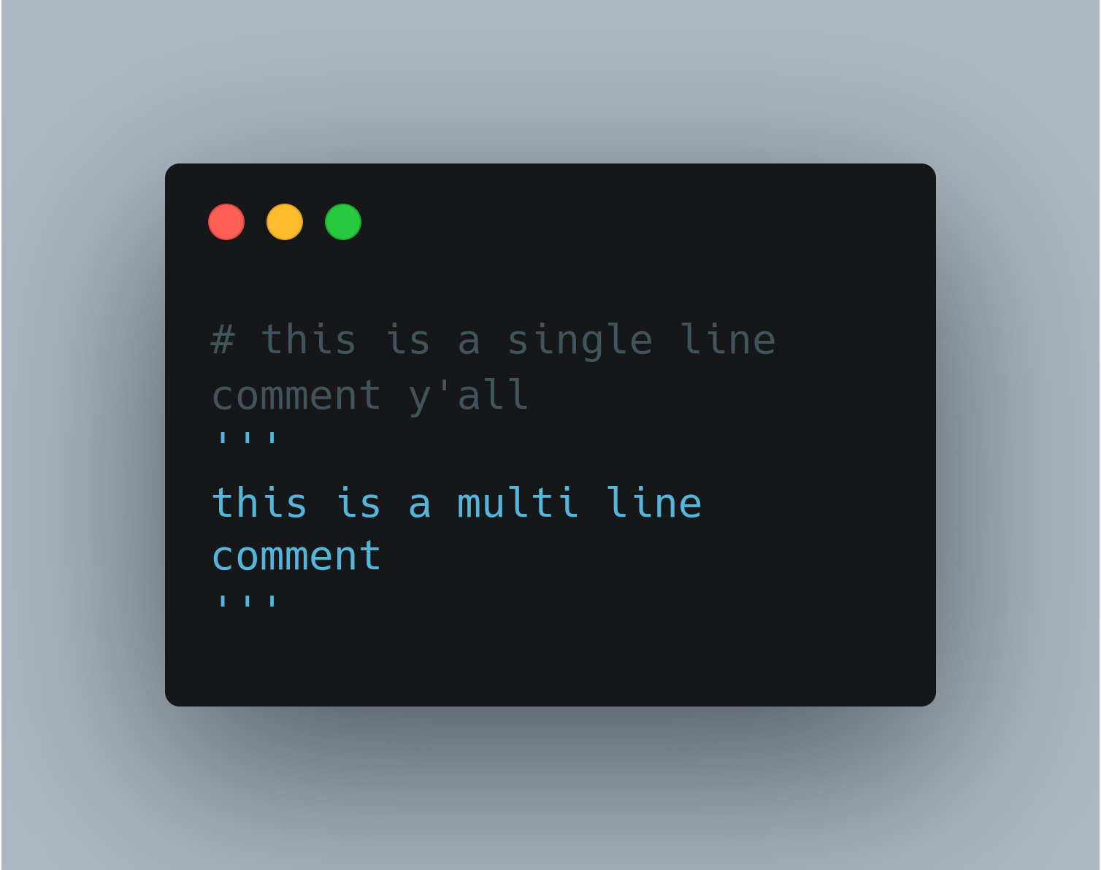
Comments

Slide 10
Thank you

